Slide 1
BASIC INDEX
Language Fundamentals
Identifiers
Data Types
Operators
Input and Output Statements
Flow Control
Strings
List Data Structure
Tuple Data Structure
Set Data Structure
Dictionary Data Structure
Functions
Modules
Packages
Exception Handling
Logging
Pickling
File Handling

Slide 2
ADVANCE INDEX
OOP
Class
Object
Method
Inheritance
Polymorphism
Data Abstraction
Encapsulation
Regular Expressions
Multi Threading
Python Database Connectivity(PDBC)

Slide 3
Python – Guido Van Rossum 1989(28feb 1991) National Research Institute (Netherland)
1) Easy To learn High Level
2) Less code
3) AI, ML, DL, NN, ds, IOT General Purpose
Programing Language
PYTHON

Slide 4
Comparison b/w languages
C lang | Java | Python
#include <stdio.h> main() { printf(“Hello World”); } Compile & Run | public class Test { public static void main(String[] args) { System.out.println(“Hello World”); } } Compile & Run | print(“Hello World”) RUN

Slide 5
Comparison b/w languages
C lang | Java | Python
#include <stdio.h> main() { int a,b; a = 10; b = 20; printf(“The sum : %d”,(a+b)); } | public class Test { public static void main(String[] args) { int a,b; a = 10; b = 20; System.out.println(“The sum is:”+ (a+b)); } } | a = 10 b = 20 print(“The sum is:”, a+b)

Slide 6
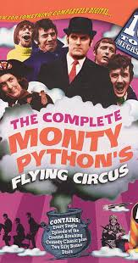
Why name is Python
Complete Monty’s Python circus
Broadcasting in BBC
1969 to 1974

Slide 7
Benefits and Compare
C :- Functional Programing Language
C++, Java :- OOP Language
Perl, Shell Script :- Scripting Language
Python :- Functional Programming (From C) OOP Language from(C++) Scripting Language (Perl, Shell Scripting) (ALL ROUNDER) Modular Programming (Modula - 3)

Slide 8
Where we can use Python:-
Desktop Applications
Web Application. (Django, Flask, Pyramid)
Network Application – Python Networking (Client server Applications)
Games
Data Analysis Applications
Machine Learning, Deep learning, Neural Network, Artificial Intelligence, IOT….
Every where can use as a general purpose programming language…..
Google
Facebook
Instagram
Spotify
Quora
Netflix
Dropbox
Reddit
YouTube
NASA
NSA
Bit Torrent

Slide 9
Python Features
Simple and Easy to learn
Freeware and open source
High level programming language
Platform independent
Portability
Dynamically Typed
Procedure Oriented & Object oriented
Interpreted
Extensible
Embedded
Extensive library

Slide 10
Simple and Easy to Learn
Java | Python
Reserved Words = 53 | Reserved Words = 36
X = (10>20)? 30:40 | X = print(30) if 10>20 else print(40)
Buffer Reader File Reader Line by Line Reading | print(open(‘abc.txt’).read())
 | Concise Code

Slide 11
Freeware and open source
Python is free for all every work or business | Python source code is open for all We customize according to our requirement And we can use it.
JAVA = oracle (Business Org) (from 11 version have to pay) C#.NET = Microsoft (Business Org) (Have to buy License) Python = PSF (NPO)(Free for all) Python Software Foundation
Jython (Java with Python)
Iron Python (C#.net application)
Anaconda Python(Big Data)
Python

Slide 12
High level programming language
Programmer friendly language
We don’t require to worry about Low level activities
Memory Allocation
How Object Destroyed
Security
PVM
(Python Virtual Machine)

Slide 13
Platform independent
Python Application
PVM for windows
PVM for Linux
PVM for MAC
Windows Platform
Linux Platform
MAC Platform
Python application is independent but the Python Virtual machine is platform dependent.
Write python applications once and use it everywhere.

Slide 14
Portability
Windows Machine
Linux Machine
Python Application
Python Application
Migrating python application from one platform to another.

Slide 15
Dynamically Typed
JAVA | PYTHON
a = 10; (cannot find symbol[error]) (we have to declare the data type) Again trying to assign in same variable a = “java”; (string cant be converted to……) Its called statically typed language…. | a = 10 (its perfectly accepted) (its automatically consider data type) Again trying to assign in same variable a = “python” (successfully assign………..) Its called dynamically typed language……

Slide 16
Procedure Oriented & Object oriented
C ====➔ Procedure Oriented (missing OOPs concept) Java ==➔ OOP (missing procedure concept)
Procedure Oriented
OOP
Scripting Language
Modular
PYTHON

Slide 17
Interpreted
C =====➔ Compile & execute JAVA ===➔ Compile & RUN Python ====➔ RUN

Slide 18
Extensible
We have a code of thousand lines in java allow to use in python.
We can approve performance of the application.
Its is interpreted language that’s why its performance is fast.
What ever any other language we have to use ….
We can use it in python.

Slide 19
Embedded
We can use python program in any other programming languages happily that’s why python is embedded language……..
Python applications can be embedded In any languages any where… its can be become powerful and get scalability of application rise……
Thousands of library are available inside python…. For every requirements have available libraries…
Complex requirements also with libraries.… we can happily write a code……
its also python specific behavior this much libraries support no other languages have……..
Extensive Library

Slide 20
Rules to define Identifiers
Identifiers
Name in python program…
It can be variable name, class name or method name.
Alphabets symbols (both upper case and lower case use)
Digits (0 to 9) (its should not start with digits)
Underscore (_) use can be use
Cant use alphanumeric symbols……(@,#,$ etc. …. its not allowed)
Its are case sensitive
We cant use reserved keywords as an identifiers…
There is no length limit for identifiers……

Slide 21
Reserved Words
There are 36 reserved words there
__peg_parser__
False await else import pass
None break except in raise
True class finally is return
and continue for lambda try
as def from nonlocal while
assert del global not with
async elif if or yield

Slide 22
Examples
String Length a = "Hello, World!" print(len(a)) | String Methods print(a.lower()) print(a.strip()) print(a.upper()) print(a.replace("H", "J")) print(a.split(",")) | Check String txt = "The rain in Spain stays mainly in the plain" x = "ain" in txt print(x) x = "ain" not in txt print(x) | quantity = 3 itemno = 567 price = 49.95 myorder = "I want to pay {2} dollars for {0} pieces of item {1}.“ print(myorder.format(quantity, itemno, price)) | String Methods capitalize() casefold() center() count() encode() endswith() expandtabs() find() format() format_ map() index() isalnum() isalpha()
String Concatenation a = "Hello" b = "World" c = a + b print(c) | String Format age = 36 txt = "My name is John, I am " + age print(txt) | age = 36 txt = "My name is John, and I am {}" print(txt.format(age)) The format() method takes the passed arguments, formats them, and places them in the string where the placeholders {} | String Methods translate() upper() zfill() rsplit() rstrip() split() splitlines() rfind() rindex() rjust() rpartition() swapcase() title() startswith() strip() | String Methods islower() isnumeric() isprintable() isspace() istitle() isupper() join() isdecimal() isdigit() isidentifier() ljust() lower() lstrip() maketrans() partition() replace()

Slide 23
Data Types
WE NO NEED TO DECLARE DATA TYPES………(python is Dynamically Typed PL.)
Int , float , bool , str , bytes , bytearray , range , list , tuple , set
Frozenset , dict , complex , None
Note:- In Python every thing is an object.
If you want to represnt integral values (without decimal point values),
we can’t declare int data type.
ex:-3,4,6,....
Mobile_no- 7398135974,rollno=17108355500012
In Python 3- long datatype is not available but version 2 it is there.
Int Data Types

Slide 24
There 4 ways to represnt int values
1-Decimal Form (Base-10)[0-9]
Ex. a=6767
print(a)
2-Binary Form (Base-2)[0 and 1 allowed]
a=0b1111 or a=0B1111 [0b or 0B represent Binary value]
print(0b1111)--15
3-Octal Form [Base-8][0-7 digits are allowed]
Ex: a=777
for octal no.. [0o or 0O represent Octal no..]
a=0o7777

Slide 25
4-Hexa Decimal Form (Base -16)[0,9, a to f or A to F]
[0x or 0X represent Hexa Deicmal no..]
Ex:-
a=0xface
print(a)
b=0xswati //invalid
a=10
b=0b10
c=0o10
d=0x10
print(a) ----10
print(b) ---binary --2
print(c) ---- octal--8
print(d) ----Hexa ---16
x = 10
Base conversion…….
bin(x)
oct(x)
hex(x)
Any base is convert to required base………..

Slide 26
Float data types
If we want any decimal types value
then it will be in float type value.
salary : 2345.67
good price: 75.98
For floating point type data type the only allowed decimal value only… octal, binary, hexadecimal values are not allowed.
Exponential Form
1.2e3 ➔ 1.2 x 10³ ➔ 1200.0

Slide 27
Bool Data Type
True and False we use only
True ---represent in Pyhton as 1
False--- represent in Python as 0
True+True=2
True+False=1

Slide 28
Complex datatype
a+bj
a=real part ; b=Imaginary part ; j only , no any other character we can use..
j^2=-1
ex:
x=10+20j // valid
x=20+21i //invalid
Note:-real part you can take any decimal,octal,binary,Hexadecimal but imaginary part should be only decimal.
ex:-
x=0b1111+20j valid
print(x)==>15+20j
a=15+0b1111j //invalid
Note: we can also perform various operation on complex datatype
a=10+20j
b=20+30j
print(a+b)
print(a*b)
print(a-b)
x.real ➔10
x.Imag ➔ 20

Slide 29
String Data Type
This data type is used to represent String value(group of characters)
we can represent string value in
single quotes
a = ‘abc’
double quotes
a = “abc”
triple qoutes : - for Multiple Lines we use.
a = ‘’‘abc or a= “””abc
xyz’’’ xyz”””

Slide 30
Tuple Data Type
t = (10,’haxkd’,20,10)
t[0] = 100 its not possible b’coz its immutable
In tuple order is important , duplicates are allowed
Heterogeneous(different types of) object are allowed
Growable not allowed and increasing/decrissing not possible .
Values must be enclose in ()

Slide 31
List Data Type
x = []
x.append(10)
x.append(20)
x.append(‘haxkd’)
x.append(None)
x[1] = 10
x.append(30)
x.insert(2,70)
x.remove(20)
print(x)
In list order is important , duplicates are allowed
Heterogeneous(different types of) object are allowed
Growable allowed happily increasing/decrissing possible
Values must be enclose in []

Slide 32
Bytes Data Type
Byte data type is immutable
We cant able to change the value
x = [10,20,30] x = (10,20,30) x = {10,20,30}
b = bytes(x)
for x in b : print(x)
-----------------------------------------------------------
b[1] = 10 its not possible
Bytes must be in range 0 to 256

Slide 33
ByteArray Data Type
Byte data type is mutable
We can able to change the value
X = [10,20,30]
b = bytearray(x)
for x in b : print(x)
-----------------------------------------------------------
b[1] = 100 its possible
ByteArray must be in range 0 to 256

Slide 34
Range Data Type
Range data type is use to return multiple value in a certain range.
Range(10)
range(10,50)
range(10,50,5)
range(10.5,50.5) its cant possible (float cant use in range)
l = list(range(10))

Slide 35
Set Data Type
x = {}
x={10,20,30}
print(x)
In set is order is not important , duplicates are not allowed
Heterogeneous(different types of) object are allowed
Growable allowed happily increasing/decrissing possible
Values must be enclose in {}
s[0] set doesnot support indexing
x.add(50) support
x.remove(10) support

Slide 36
Frozenset Data Type
A group of unique value does not allow to change the value.
x = {10,20,30,40}
fx=frozenset(x)
fx.add(50) does not support
fx.remove(10) does not support

Slide 37
Dict Data Type
d = {100: ‘btps’, 200:’haxkd’}
Dictionary is mutable.
Value can be duplicate but Key cant be dublicate.
d.keys()
d.values()

Slide 38
slice operator
IT is very useful operator used in Python
it is used to get substring.
Syntax:
s[beginindex:endindex]
Note: EndIndex always end-1 index.
s[1:4]==>tps
s[2:6]==>psin
s[1:]==>tpsindia [end index is optional]
s[:4]==>btps
if you are not specifying begin index then by default it is consider as 0 index.
s[:100] ==>valid btpsindia

Slide 39
Python Type Conversion and Type Casting
Type Conversion
The process of converting the value of one data type (integer, string, float, etc.) to another data type is called type conversion. Python has two types of type conversion.
Implicit Type Conversion
Explicit Type Conversion
Implicit Type Conversion
In Implicit type conversion, Python automatically
converts one data type to another data type.
This process doesn't need any user involvement.
Python promotes the conversion of the lower data
type (integer) to the higher data type (float) to avoid data loss.
num_int = 123
num_flo = 1.23
num_new = num_int + num_flo print("datatype of num_int:",type(num_int)) print("datatype of num_flo:",type(num_flo))
print("Value of num_new:",num_new) print("datatype of num_new:",type(num_new))

Slide 40
Explicit Type Conversion
num_int = 123
num_str = "456"
print("Data type of num_int:",type(num_int))
print("Data type of num_str:",type(num_str)) print(num_int+num_str)
In Explicit Type Conversion, users convert the data
type of an object to required data type. We use the
predefined functions like int(), float(), str(), etc to perform
explicit type conversion.
This type of conversion is also called typecasting because the user casts (changes) the data type of the objects.
num_int = 123
num_str = "456"
print("Data type of num_int:",type(num_int))
print("Data type of num_str before Type Casting:",type(num_str))
num_str = int(num_str)
print("Data type of num_str after Type Casting:",type(num_str))
num_sum = num_int + num_str
print("Sum of num_int and num_str:",num_sum)
print("Data type of the sum:",type(num_sum))

Slide 41
Key Points to Remember
Type Conversion is the conversion of object from one data type to another data type.
Implicit Type Conversion is automatically performed by the Python interpreter.
Python avoids the loss of data in Implicit Type Conversion.
Explicit Type Conversion is also called Type Casting, the data types of objects are converted using predefined functions by the user.
In Type Casting, loss of data may occur as we enforce the object to a specific data type.

Slide 42
Python Input, Output and Import
Python Output Using print() function
print(“Hello World”)
Output Formatting
print('I love {0} and {1}'.format('bread','butter'))
print('I love {1} and {0}'.format('bread','butter'))
print('Hello {name}, {greeting}'.format(greeting = ‘hello', name = ‘haxkd'))

Slide 43
Python Input
To allow flexibility, we might want to take the input from the user. In Python, we have the input() function to allow this.
The syntax for input() is:
input([prompt])
where prompt is the string we wish to display on the screen.
It is optional.
eval('2+3+54+67+587‘)
Python Import
When our program grows bigger, it is a good idea to break it into different modules.
A module is a file containing Python definitions and statements. Python modules have a filename and end with the extension .py.
Definitions inside a module can be imported to another module or the interactive interpreter in Python. We use the import keyword to do this.
For example, we can import the math module by typing the following line:
import math
num = input('Enter a number:)
num '10‘

Slide 44
Python Import
import math
print(math.pi)
Now all the definitions inside math module are available in our scope. We can also import some specific attributes and functions only, using the from keyword.
For example:
>>> from math import pi
>>> pi
3.141592653589793

Slide 45
Python Operators
Operators are special symbols in Python that carry out arithmetic or logical computation. The value that the operator operates on is called the operand.
For example:
>>> 2+3
5
Arithmetic operators
Arithmetic operators are used to perform mathematical operations like addition, subtraction, multiplication, etc.

Slide 46
Operator | Meaning | Example
+ | Add two operands or unary plus | x + y+ 2
- | Subtract right operand from the left or unary minus | x - y- 2
* | Multiply two operands | x * y
/ | Divide left operand by the right one (always results into float) | x / y
% | Modulus - remainder of the division of left operand by the right | x % y (remainder of x/y)
// | Floor division - division that results into whole number adjusted to the left in the number line | x // y
** | Exponent - left operand raised to the power of right | x**y (x to the power y)

Slide 47
Comparison operators
Comparison operators are used to compare values. It returns either True or False
according to the condition.
Operator | Meaning | Example
> | Greater than - True if left operand is greater than the right | x > y
< | Less than - True if left operand is less than the right | x < y
== | Equal to - True if both operands are equal | x == y
!= | Not equal to - True if operands are not equal | x != y
>= | Greater than or equal to - True if left operand is greater than or equal to the right | x >= y
<= | Less than or equal to - True if left operand is less than or equal to the right | x <= y

Slide 48
Logical operators
Logical operators are the and, or, not operators.
Operator | Meaning | Example
and | True if both the operands are true | x and y
or | True if either of the operands is true | x or y
not | True if operand is false (complements the operand) | not x

Slide 49
Bitwise operators
Bitwise operators act on operands as if they were strings of binary digits. They operate bit by bit, hence the name.
For example, x = 2 is y = 10 in binary of x is 0010 and y 1010.
Operator | Meaning | Example
& | Bitwise AND | x & y = 2(0010)
| | Bitwise OR | x | y = 10 (1010)
~ | Bitwise NOT | ~x = -3
^ | Bitwise XOR | x ^ y = 8(1000)
>> | Bitwise right shift | x >> 2 = 0 (0000)
<< | Bitwise left shift | x << 2 = 8 (1000)

Slide 50
Assignment operators
Assignment operators are used in Python to assign values to variables.
a = 5 is a simple assignment operator that assigns the value 5 on the right to the variable a on the left.
There are various compound operators in Python like a += 5 that adds to the variable and later assigns the same. It is equivalent to a = a + 5.

Slide 51
Operator | Example | Equivalent to
= | x = 5 | x = 5
+= | x += 5 | x = x + 5
-= | x -= 5 | x = x - 5
*= | x *= 5 | x = x * 5
/= | x /= 5 | x = x / 5
%= | x %= 5 | x = x % 5
//= | x //= 5 | x = x // 5
**= | x **= 5 | x = x ** 5
&= | x &= 5 | x = x & 5
|= | x |= 5 | x = x | 5
^= | x ^= 5 | x = x ^ 5
>>= | x >>= 5 | x = x >> 5
<<= | x <<= 5 | x = x << 5

Slide 52
Special operators
Python language offers some special types of operators like the identity operator or the membership operator. They are described below with examples.
Identity operators
is and is not are the identity operators in Python. They are used to check if two values (or variables) are located on the same part of the memory.
Two variables that are equal does not imply that they are identical.
Operator | Meaning | Example
is | True if the operands are identical (refer to the same object) | x is True
is not | True if the operands are not identical (do not refer to the same object) | x is not True

Slide 53
Membership operators
in and not in are the membership operators in Python. They are used to test whether a value or variable is found in a sequence (string, list, tuple, set and dictionary).
In a dictionary we can only test for presence of key, not the value.
Operator | Meaning | Example
in | True if value/variable is found in the sequence | 5 in x
not in | True if value/variable is not found in the sequence | 5 not in x

Slide 54
Escape Characters:
\n Next Line
\t Next Tab
\r carriage return
\b backslash
\f form feed
\’
\’’\
\\
\v

Slide 55
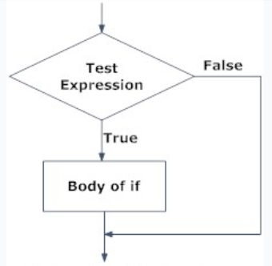
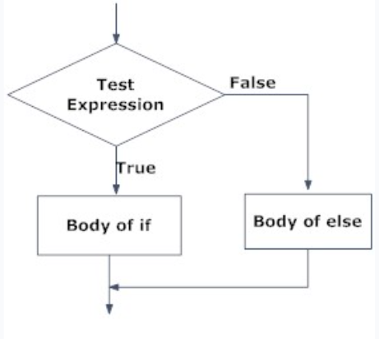
Python if...else Statement
What is if...else statement in Python?
Decision making is required when we want to execute a code only if a certain condition is satisfied.
The if(): elif(): else: statement is used in Python for decision making.
Syntax of if...else
if test expression:
Body of if
else:
Body of else

Slide 56
Examples
a = 200 b = 33 if b > a: print("b is greater than a") elif a == b: print("a and b are equal") else: print("a is greater than b")
Example: Python if Statement
num = 3
if num > 0:
print(num, "is a positive number.")
print("This is always printed.")
num = -1
if num > 0:
print(num, "is a positive number.")
print("This is also always printed.")
a = 200 b = 33 c = 500 if a > b or a > c: print("At least one of the conditions is True")
if a > b and c > a:
print("Both conditions are True")
a = 33 b = 33 if b > a: print("b is greater than a") elif a == b: print("a and b are equal")
Example of if...else
num = 3
if num >= 0:
print("Positive or Zero")
else:
print("Negative number")
a = 2 b = 330 print("A") if a > b else print("B")
print("A") if a > b else print("=") if a == b else print("B")

Slide 57
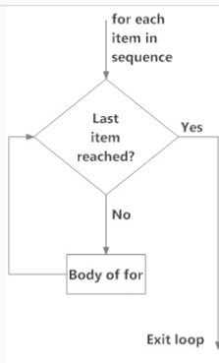
Python for Loop
The for loop in Python is used to iterate over a sequence (list, tuple, string) or other iterable objects. Iterating over a sequence is called traversal.
Syntax of for Loop
for val in sequence:
Body of for
Here, val is the variable that takes the value of the item inside
the sequence on each iteration.
Loop continues until we reach the last item in the sequence.
The body of for loop is separated from the rest of the code using indentation.
When we don’t know the loop where to start and where to end.

Slide 58
Example
student_name = 'Soyuj'
marks = {'James': 90, 'Jules': 55, 'Arthur': 77}
for student in marks:
if student == student_name:
print(marks[student])
break
else:
print('No entry with that name found.')
digits = [0, 1, 5]
for i in digits:
print(i)
else:
print("No items left.")
numbers = [6, 5, 3, 8, 4, 2, 5, 4, 11]
sum = 0
for val in numbers:
sum = sum+val
print("The sum is", sum)
numbers = [1, 2, 3]
chars = ["a", "b", "c"]
for x in numbers:
for y in chars:
print(x, y)
genre = ['pop', 'rock', 'jazz']
for i in range(len(genre)):
print("I like", genre[i])

Slide 59
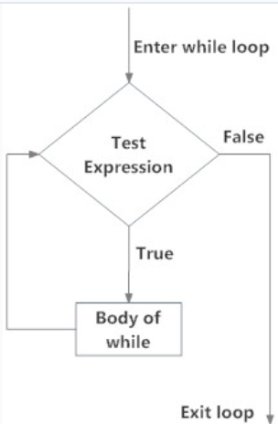
Python while loop
The while loop in Python is used to iterate over a block of code as long as the test expression (condition) is true.
We generally use this loop when we don't know the number of times to iterate beforehand.
Syntax of while Loop in Python
while test_expression:
Body of while
Hf

Slide 60
Example
n = 10
sum = 0
i = 1
while i <= n:
sum = sum + i
i = i+1 # update counter
print("The sum is", sum)
counter = 0
while counter < 3:
print("Inside loop")
counter = counter + 1
else:
print("Inside else")

Slide 61
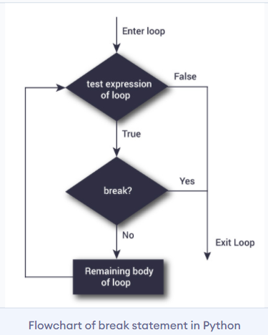
Python break and continue
In Python, break and continue statements can alter the flow of a normal loop.
Loops iterate over a block of code until the test expression is false, but sometimes we wish to terminate the current iteration or even the whole loop without checking test expression.
The break and continue statements are used in these cases.
Python break statement
The break statement terminates the loop containing it.
Control of the program flows to the statement
immediately after the body of the loop.
If the break statement is inside a nested loop
(loop inside another loop), the break statement
will terminate the innermost loop.
Syntax of break
break

Slide 62
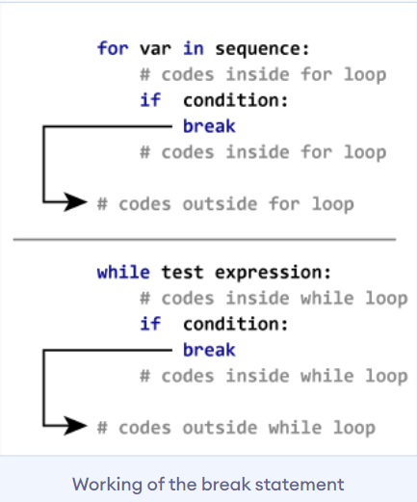
Example: Python break
for val in "string":
if val == "i":
break
print(val)
print("The end")
s = 'geeksforgeeks'
for letter in s:
print(letter)
if letter == 'e' or letter == 's':
break
print("Out of for loop")
print()
i = 0
while True:
print(s[i])
if s[i] == 'e' or s[i] == 's':
break
i += 1
print("Out of while loop")

Slide 63
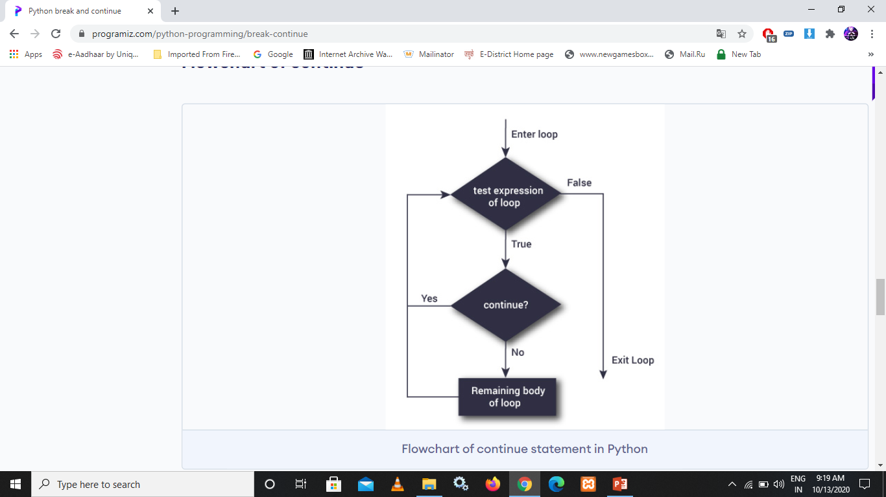
Python continue statement
The continue statement is used to skip the rest of the code inside a loop for the current iteration only. Loop does not terminate but continues on with the next iteration.
Syntax of Continue
continue
for val in "string":
if val == "i":
continue
print(val)
print("The end")

Slide 64
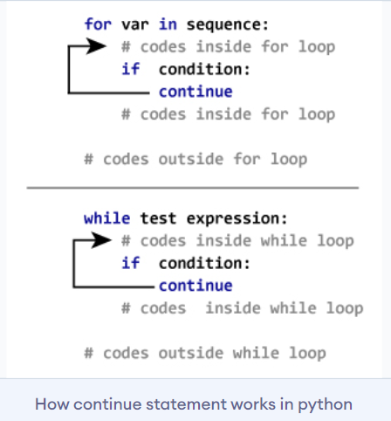
Example: Python Continue
for i in range(1, 11):
if i == 6:
continue
else:
print(i, end = " ")

Slide 65
Python pass statement
In Python programming, the pass statement is a null statement. The difference between a comment and a pass statement in Python is that while the interpreter ignores a comment entirely, pass is not ignored.
However, nothing happens when the pass is executed. It results in no operation (NOP).
Syntax of pass
pass
s = "geeks"
for i in s:
pass
def fun():
pass
fun()
for i in s:
if i == 'k':
print('Pass executed')
pass
print(i)
sequence = {'p', 'a', 's', 's'}
for val in sequence:
pass

Slide 66
Summary
The for and while loops are used for iteration
They are used to execute a set of statements multiple times or to iterate over a collection such as a list
The for loop in python can also be used with the range() method. You can either provide both lower and upper limits or only upper limit. In the latter case, 0 will be assumed as the lower limit
Use the for loop when you know how many times the loop should execute
The while loop has a condition and it runs until the condition is false
The while loop should always have a mechanism to break the condition or the loop will run forever
Use the while loop when you do not know many times the loop should execute
The else block can be used with both the for and while loop. It is always executed.
The break keyword is used to terminate the execution. No further iteration will be done if the break keyword is encountered.
The continue keyword skips the current iteration and jumps directly to the next iteration.

Slide 67
Del operator
x = 10
del x
y = 10
x=10
del x,y
For deleting the variable not the object
X = 10
X1 = 10
X2 = 10
del x1

Slide 68
String
A string is a sequence of characters.
A character is simply a symbol. For example, the English language has 26 characters.
Computers do not deal with characters, they deal with numbers (binary). Even though you may see characters on your screen, internally it is stored and manipulated as a combination of 0s and 1s.
This conversion of character to a number is called encoding, and the reverse process is decoding. ASCII and Unicode are some of the popular encodings used.
x = ‘a’ it’s a string not char
x = ‘’’abcde
fghi’’’
x = “””abcde
Fgh”””

Slide 69
S = ‘This is ‘ a single Quote’ or “This is ‘ a single Quote” or ‘This is \‘ a single Quote’
s = “This is “ a double Quote” or ‘This is “ a double Quote’ or “This is \” a double Quote”
s = These are ‘ and “ symbols or ‘These are \‘ and “ symbols’ or ‘’’These are ‘ and “ symbols’’’
How To access characters of the string:
By using index
By using slice operator
1. By using index
s = “BTPS”
print(s[0])
print(s[-1])

Slide 70
Write a program to print all character with index
s = input(“Input some string”)
i = 0
For x in s:
print(“The character present at positive index: {} and at negative index: {} is : {}”.format(i,i-len(s),x))
i = i+1
Both +ve and –ve index
+ve index ➔ forward direction (Left to right )
-ve index ➔ backward direction (Right to Left)

Slide 71
By using slice operator
s[beginindex:endindex:step]
s = ‘BTPS’
s[0:3:1]
From begin index to end -1 index and everytime increment by 1
Step value can be either +ve or –ve
If +ve then it should be forward direction (left to right)
If -ve then it should be backward direction (right to left)

Slide 72
Mathematical Operators
+ and *
S = ‘BTPS’+’kanpur’ concanating two dtrings
s= “btps” s*5 repeating multiple time

Slide 73
Remove Spaces from string
lstrip() Removes spaces from left side
rstrip() removes Spaces from right side
strip() Removes spaces from start and end both
s = input(‘Enter a string’)
s = s.strip()
print(s)

Slide 74
Find substring from string
string.find(value,start,end)
S = input(“Enter main string: ”)
subs= input(“Enter Substring: ”)
flag = False
pos = -1
n = len(s)
count = 0
While True:
pos = s.find(subs,pos+1,n)
if pos==-1:
break
print(“Found at index:”,pos)
flag = True
if flag == False:
print(“Not Found”)
print(“No. of occurences:”,count)
If you want to check how many times a substring present in the given string:
string.count(substring)
string.count(substring,Begin,End)

Slide 75
Replacement operation
string.replace(oldstring,newstring)
s = “Python Learning is Difficult”
s = s.replace(“Diffcult”,”Easy”)
String is immutable that’s why replace function creates a new object with new string

Slide 76
Spliting of string
string.split(seperator)
s = “BTPS KANPUR INDIA”
l = s.split()
s= “04-12-2000”
l = s.split(-)
split(separator,max split)
rsplit(separator,max split)
lsplit(separator,max split)

Slide 77
Join operation
seperator.join(string)
t= [‘BTPS’, ‘KANPUR’, ‘INDIA’]
s= ‘-’.join(t)
print(s)

Slide 78
Sorting a given alphanumeric string
s= input(“Enter some string”)
s1=s2=output=‘’
for x in s:
if x.isalpha():
s1=s1+x
else:
s2 = s2+x
for x in sorted(s1):
output=output+x
for x in sorted(s2):
output2=output2+x
print(output)
print()
print(output2)

Slide 79
Input : a4b3c2 output: aaaabbbcc
s= input(“Enter some string”)
output=‘’
for x in s:
if x.isalpha():
output=output+x
previous=x
else:
output=output+previous*(int(x)-1)
print(output)

Slide 80
input: a4k3b2 output: aeknbd
s = input(“Enter some string”)
output=‘’
for x in s:
if x.isalpha():
output= output+x
previous=x
else:
newch = chr(ord(previous)+int(x))
output = output+newch
print(output)

Slide 81
input1: ABCD input2: EFGH output: AEBFCGDH
s1 = input(“Enter First String:”)
s2 = input(“Enter Second String:”)
output=‘’
i = j = 0
while i<len(s1) or i<len(s2):
if i<len(s1):
output = output+s1[i]
i = i+1
if j<len(s2):
output = output+s2[j]
j = j+1
print(output)

Slide 82
List Data Type
Index(+ve or -ve)
Slice
a list can contain another list is called nested list….
[10,20,[30,40]]
we can read elements of the list using while loop or for loop
its mutable we can perform any type of changes
l = [1,2,3,4,5,6,7]
i<0
while i<len(l) :
print(l[i])
I = i+1
for x in l:
print(x)
To display only even numbers
for x in l:
if x%2==0:
print(x)
l = [“A”,”B”,”C”,”D”]
x= len(l)
for i in range(x):
print(l[i],”is available at positive index:”,i,”and at negative index:”,i-x)

Slide 83
Important methods and functions of List:
1. len(list)
2. list.count(element)
3. list.index(element)
4. list.append(element)
5. list.insert(index,element)
6. list1.extend(list2)
7. remove(x)
8. pop(index)
9. reverse()
10. list.sort()

Slide 84
List Comprehensions:
list= [expression for x in n sequence]
list=[x*x for x in range(1,11)]
list=[expression for x in sequence if condition ]
list2=[x for x in list if x%2==0]

Slide 85
To get information about list:
len(): returns the number of elements present in the list
Eg: n=[10,20,30,40]
print(len(n))==>4
count(): It returns the number of occurrences of specified item in the list
n=[1,2,2,2,2,3,3]
print(n.count(1))
print(n.count(2))
print(n.count(3))
print(n.count(4))
index() function: returns the index of first occurrence of the specified item.
Eg:
n=[1,2,2,2,2,3,3]
print(n.index(1)) ==>0
print(n.index(2)) ==>1
print(n.index(3)) ==>5

Slide 86
extend() function: To add all items of one list to another list
l1.extend(l2)
to l1
Eg: all items present in l2 will be added
order1=["Chicken","Mutton","Fish"]
order2=["RC","KF","FO"]
order1.extend(order2)
print(order1)
➔ ['Chicken', 'Mutton', 'Fish', 'RC', 'KF', 'FO’]

Slide 87
reverse(): We can use to reverse() order of elements of list.
n=[10,20,30,40]
n.reverse()
print(n)
[40, 30, 20, 10]
sort() function: In list by default insertion order is preserved. If want to sort the elements of list according to default natural sorting order then we should go for sort() method.
For numbers ==>default natural sorting order is Ascending Order
For Strings ==> default natural sorting order is Alphabetical Order
n=[20,5,15,10,0]
n.sort()
print(n) ➔ [0,5,10,15,20]
s=["Dog","Banana","Cat","Apple"]
s.sort()
print(s) ➔['Apple','Banana','Cat','Dog']

Slide 88
clear() function: We can use clear() function to remove all elements of List
n=[10,20,30,40]
print(n) ➔ [10,20,30,40]
n.clear()
print(n) ➔ []

Slide 89
Tuple Structure
empty tuple t = ()
One Element Tuple t = (10,) (if not use comma its differ as int type else tuple(group of values) type)
Multi values tuple t = (10,20,30)
By sequence t = tuple(sequence)
Access elements of Tuple
Index or Slice
Mathematical operator +

Slide 90
Sorting Tuple
t1 = (30,10,50,40,20)
t1.sort() //invalid
t2 = tuple(sorted(t1))
max(t1)
min(t1)
De-assign tuple
a,b,c,d,e = t1

Slide 91
Set Data Type Components
S = {10,20,30}
s.add(40) //VALID
s.update(10) //INVALID (we have to give a sequence of data)
s.add(‘haxkd’) //valid
s.update(‘haxkd’) //VALID
Copy method //backup copy➔Cloning
s1=s.copy()
POP method //Remove and return the element some random element
s.pop()
s.remove(10) //for removeing purpose
s.discard(10) //don’t give error if element havnt which I want to remove
s.clear() //clear complete set

Slide 92
Mathematical Operation in set
S1 = {10,20,30}
s2={40,50,60}
s1.union(s2)
s1.intersection(s2)
s1.difference(s2)
s1.symmetric_difference(s2)
in and not in operator in set

Slide 93
To eliminate duplicates present in the list
l = eval(input(“Enter some list of values”))
s= set(l)
print(s)
l = eval(input(“Enter some of Words”))
s= set(l)
print(s)

Slide 94
SET COMPREHENSION
s = {i**2 for i in range(1,11)}
print(s)

Slide 95
Dictionary Data structure
d = {}
d[‘name’] = ‘btps’
d[‘area’] = ‘kanpur’
print(d)
d[key] = value
d.get(key)
How to Delete elements from the dict?
del d[key]
pop(key)
d.popitem() //delete any key item
d.clear() //clear complete dict

Slide 96
Write a program to enter name and % of marks in a dict and display info on the screen
rec = {}
n = int(input(“Input Number of students:”))
i = 1
while i <=n:
name = input(“Enter Student Name : ”)
marks = input(“Enter % of marks: ”)
rec[name] = marks
i = i+1
print(“Name of student”,”\t”,”%of marks”)
for x in rec:
print(“\t”,x,”\t\t”,rec[x])

Slide 97
Update and Add in dict
d= {1:’hello’,2:’bye’}
d1={10:’scdc’20:’sasc’}
d.update(d1)

Slide 98
Take dictionary from input and print sum of values….
sum() function is use to return sum of all value which present in given multiple value of the list/set/tuple/dict
d = eval(input(“Enter Dictionary: ”))
s = sum(d.values())
print(“The sum is”,s)
---------------------------------------------------------------------------------------------------
word=input(“Enter some word: ”)
d= {}
for x in word:
d[x] = d.get(x,0)+1
for k,v in sorted(d.items()):
print(“{} occurred {} times”,format(k,v))

Slide 99
Dictionary Comprehension
d = {i: (‘even’ if i%2==0 else ‘odd’) for i in range(1,11)}
print(d)
d = {num:num**2 for num in range(1,11)}
print(d)

Slide 100
Python functions
def abc() //use def keyword to define a function
there are multiple types of arguments functions
1. Positional
2. Keyword
3. Default
4. Var- arg (variable length arguments)

Slide 101
Positional Arguments
def calc(a,b):
sum = a+b
sub = a-b
mul = a*b
div = a/b
return sum,sub,mul,div
t = calc(100,50)
for x in t :
print(x) // Order is important
// No. of arguments is also important

Slide 102
Keyword Arguments
def calc(a,b):
calc(a=100,b=50) //order is not important
calc(b=50,a=100) //No of arguments is important
calc(100,b=50) //valid
calc(b=50,100) //After keyword arg you shouldn’t take keyword arg
calc(50,a=100) //invalid

Slide 103
Default Arguments
def wish(msg,name=“HELLO”):
pass
def wish(msg=“Hello”,name=“abc”):
pass

Slide 104
Var length Arguments
def sum(*n):
result=0
for x in n:
result=result+x
print(“The result is:”,result)
def display(**arg):
print(“Record Information”)
for k,v in arg.items():
print(k,”………..”,v)
display(name=“Abc”,marks=100,age=20,GF=“XYz”)
display(name=“xyz”,wife1=“jklm”,age=20,GF=“XYz”)

Slide 105
Module
import time
from imp import reload
import module1
print(“Program starting”)
time.sleep(30)
reload(module1)
print(“Last Line”)
A group of functions and variables saved to a file .
Reuseability,Readability,Maintainability,
import keyword use to import a module
Reloading a module………………………………………
dir()➔current module members
dir(module) ➔ Specified module members
from math import *
print(sqrt(4))
print(ceil(10.1))
print(floor(10.1))
print(fabs(-10.6))
print(fabs(10.6))

Slide 106
random module
To generate random numbers
1. random() between 0 and 1 0<x<1 (not inclusive)
2. randint(0,10) generate int number in the given range (inclusive)
3. uniform(10,20) generate float value in range (not inclusive)
4. random.randrange(start, stop, step)
5. choice(sequence) Required. A sequence like a list, a tuple, a range of numbers etc.
start | Optional. An integer specifying at which position to start. Default 0
stop | Required. An integer specifying at which position to end.
step | Optional. An integer specifying the incrementation.Default 1

Slide 107
Package➔a group of modules.
Library ➔A group of Packages.

Slide 108
Recursive Function
A function that calls its self.
Example :- factorial(n) = n*factorial (n-1)
Advantages of Recursive function:-
1.Reduce the length of the code and improve readability.
2. Towers of Hanoi
3. Very complex problems we can solve very easily.

Slide 109
Find factorial of given number using recursion:
def factorial(n):
if n==0:
result == 1
else:
result = n*factorial(n-1)
return result
print(factorial(0))
print(factorial(5))
print(factorial(10))

Slide 110
Anonymous Functions
without name or nameless function.
for instant use or only use on time
lambda input:expression
example: write program to find square
s = lambda x:x*x
print(s(2))
print(s(3))
print(s(4))
print(s(5))

Slide 111
write a anonymous function to find out biggest value from given number
s = lambda a,b = a if a>b else b
print(“The biggest value is”,s(10,20))
print(“The biggest value is”,s(200,100))
filter()
map()
reduce()
some usefull functions which need another function as arguments

Slide 112
1.Filter()
filter(function,sequence) //if function is true then sequence value will be consider
l = [0,5,10,15,20,25,30,35,40]
l1 = list(filter(lambda x:x%2==0,l))
print(l1)
l2 = list(filter(lambda x:x%2!=0,l))
print(l2)
def iseven(x):
if x%2==0:
return True
else:
return False
l = [0,5,10,15,20,25,30,35,40]
l1 = list(filter(iseven,l))
print(l1)

Slide 113
2. Map()
map(function ,sequence) //is not any true or false……. value will be consider always
l = [1,2,3,4,5]
l1 = list(map(lambda x:2*x,l))
print(l1)
l1 = [1,2,3,4,5]
l2 = [4,5,6,7,8]
l3 = list(map(lambda x,y:x*y,l1,l2))
print(l3)
def double (x):
return 2*x
l = [1,2,3,4,5]
l1 = list(map(double,l))
print(l1)

Slide 114
3. reduce()
The reduce(function,sequence) function is used to apply a particular function passed in its argument to all of the list elements mentioned in the sequence passed along.This function is defined in “functools” module.
Working :
At first step, first two elements of sequence are picked and the result is obtained.
Next step is to apply the same function to the previously attained result and the number just succeeding the second element and the result is again stored.
This process continues till no more elements are left in the container.
The final returned result is returned and printed on console.
import functools
list = [4,5,6,7,8]
print ("The sum of the list elements is : ",end="")
print (functools.reduce(lambda a,b : a+b,list))
print ("The maximum element of the list is : ",end="")
print (functools.reduce(lambda a,b : a if a > b else b,list))

Slide 115
Nested Function
def f1():
def inner(a,b):
print(“Sum is: ”,a+b)
inner(10,20)
f1()
def outer():
print(“Outer Function”)
def inner():
print(“inner”)
return inner

Slide 116
Function Decorators:
Input Function➔Decorator Function ➔ Output Function with extended functionality
Decorators help to make our code shorter and more pythonic.
def decor(func):
def inner(name):
if name == ‘ABCD’
print(“Hello ABCD BAD MORNING”)
else:
func(name)
return inner
@decor
def wish(name):
print(“Hello”,name,”Good Morning”)
wish(“XYZ”)
wish(“JKL”)
wish(“ABCD”)
without @decor
---------------------
decorfunction = decor(wish)
decorfunction(“Sunny”)

Slide 117
Example :
def smartdivision(func):
def inner(a,b):
if b==0:
print(“Stupid”)
else:
return func(a,b)
return inner
@smartdivision
def division(a,b):
return a/b
print(division(10,2))
print(division(10,0))

Slide 118
Exception Handeling
Syntax Errors Runtime Errors➔Exceptions
eg1:
x= 10
if x==10
print (“x value is 10”)
eg2:
print “Hello”
ZeroDivisionError
ValueError

Slide 119
Example
1. division by zero
2. performing an operation on incompatible types
3. using an identifier which has not been defined
4. accessing a list element, dictionary value or object attribute which doesn’t exist
5. trying to access a file which doesn’t exist
try:
print(10/0)
except:
print(“Zero error”)

Slide 120
Type Exception Handeling
Try:
Try block
Except:
Except Block
Finally:
Finally block
Else:
Else block
s
1. Without finally or except only try block is invalid.
2. Without try , except is always invalid.
3. Finally else always associated with try block
4. We can take multiple except block but cant else and finally block.
5. Else without except is invalid.

Slide 121
Types of exceptions
Predefined/In Built Exceptions
The exceptions which are raised automatically by python whenever a particular event occurs……
Eg1: print(10/0) ZeroDivisionError
Eg2: x=int(“one”) ValueError
-----------------------------------------------------------------------------------
User Defined / Customized Exceptions
if age>60:
raise TooOld(“To old to marriage”)
elif age<18:
raise TooYoung(“Age is so small to marriage”)
else:
print(“You can marriage”)
class TooYoung(Exception):
def __init__(self,arg):
self.msg=arg
class TooOld(Exception):
def __init__(self,arg):
self.msg=arg
age = int(input(“Enter age:”))

Slide 122
LOGGING
Logging is a means of tracking events that happen when some software runs. Logging is important for software developing, debugging and running. If you don’t have any logging record and your program crashes, there are very little chances that you detect the cause of the problem. And if you detect the cause, it will consume a lot of time. With logging, you can leave a trail of breadcrumbs so that if something goes wrong, we can determine the cause of the problem.
LEVEL | VALUE
1. CRITICAl | 50
ERROR | 40
WARNING | 30
4. INFO | 20
5. DEBUG | 10
6. NOTSET | 0
import logging
logging.basicConfig(filename=‘log.txt’,level=logging.WARNING)
print(“DEBUGGING”)
logging.debug(“debug message”)
logging.info(“info message”)
logging.warning(“warning message”)
logging.error(“error message”)
logging.critical(“critical message”)
basicConfig() of logging module

Slide 123
Exception in logging
import logging
logging.basicCongfig(filename=‘log.txt’,level=logging.INFO)
logging.info(“A NEW PROCESSS”)
try:
x = int(input(“Enter First Number: ”))
y = int(input(“Enter Second Number: ”))
print(x/y)
except ZerDivisionError as msg:
print(“Cannot devide with zero”)
logging.exception(msg)
except ValueError as msg:
print(“Enter integer values”)
logging.exception(msg)
logging.info(“PROCESS COMPLETED”)

Slide 124
Debugging
To check the whole program and recive the output as expected….
if the output is differ from our excpected output then it’s the bug.
to handle it we use mostly assert keyword
def avg(marks):
assert len(marks) != 0,"List is empty."
return sum(marks)/len(marks)
mark2 = [55,88,78,90,79]
print("Average of mark2:",avg(mark2))
mark1 = []
print("Average of mark1:",avg(mark1))
x = "hello"
assert x == "goodbye", "x should be 'hello'"

Slide 125
Pickling and Unpickling
If we want to write an object in a file is called pickiling….
And if we want to reading the objects from of the file is unpickling….
For this we use the module name is pickle its available on python.
wb➔Write Binary
rb➔ Read Binary
PICKLING | UNPICKLING
pickle.dump(object,file) | pickle.load(file)

Slide 126
Pickling and Unpicling Example
import pickle
class Employee:
def __init__(self,eno,ename,esal,eaddr):
self.eno=eno
self.ename=ename
self.esal=esal
self.eaddr=eaddr
def display(self):
print(self.eno,"\t",self.ename,"\t",self.esal,"\t",self.eaddr)
with open("emp.txt","wb") as f:
e = Employee(100,'Durga',1000,'Hyd')
pickle.dump(e,f)
print("Pickling done.......!")
with open("emp.txt","rb") as f:
ob = pickle.load(f)
print("Employee after unpicklig")
ob.display()
from pickle import Pickler
f = open("data.txt","wb")
dct = {'name': 'Ravi', 'age': 23, 'Gender': 'M', 'marks': 75}
Pickler(f).dump(dct)
f.close()
from pickle import Unpickler
f = open("data.txt","rb")
dct = Unpickler(f).load()
print (dct)
f.close()

Slide 127
Example of Pickling and Unpicling
from pickle import *
class person:
def __init__(self):
self.name = "XYZ"
self.age = 22
def show(self):
print ("name:", self.name, "age:", self.age)
p1 = person()
f = open("data.txt","wb")
dump(p1,f)
f.close()
print ("unpickled")
f = open("data.txt","rb")
p1 = load(f)
p1.show()

Slide 128
File Handeling
Store data in files permanently
If our data very small
---------------------------------------------------
Type of Files:
1. Text Files:
To store character data
Eg: abc.txt,abc.data etc….
2. Binary Files:
Images,videos,audio files,zip files etc…
Opening Files :
f = open(‘filename’,mode)
The modes are :
----------------------
r ➔ right
w ➔write
a ➔append
r+ ➔read and write
w+ ➔ write and read
a+ ➔append and read
x ➔ exclusive mode

Slide 129
READING A FILE
1. r
open an existing file for read operation……
f = open(‘abc.txt’) //This is the default mode
2. w
open an existing file for writing…..
file available but contains some data…. then overwrite it.
if file is not available its create itself.
3. a
f = open(‘abc.txt’,’a’)
4. r+ (read and write) //privous data would not be deleted… file should be available
f = open(‘abc.txt’,’r+’)

Slide 130
5. w+ (write and read) //privous data would be deleted…
f = open(‘abc.txt’,’w+’)
6. a+ append with overriding and read
f = open(‘abc.txt’,’a+’)
7. x
to open a file in exclusive mode for write….(file should not be available)
f = open(‘abc.txt’,’x’)

Slide 131
Getting properties of file:
f.name ➔ name of the opened file
f.mode ➔ in which mode file is opend
f.closed ➔ if files is closed returns Boolean value
its all the variables
f.readable()
f.writable()

Slide 132
write data in file
f = open(‘abc.txt’,’w’)
f.write(‘BTPS’)
f.write(‘KAKADEO\n’)
f.write(‘KANPUR\n’)
f.write(‘INDIA\n’)
print(“Done…………!”)
f.close()
f = open(‘abc.txt’,’w’)
list = [‘BTPS\n’,‘KAKADEO\n’,‘KANPUR\n’,‘INDIA’]
f.writelines(list)
print(“Done…………!”)
f.close()

Slide 133
Reading char data from file
f.read() ➔ To read total data
f.read(n) ➔ to read n chara from the file
f.readline() ➔ to read only one line
f.readlines() ➔ to read all lines into a list
f = open('newfile.txt')
print(f.read())
f.close()
f = open('newfile.txt')
print(f.readline())
print(f.readline())
f.close()
f1 = open(‘file1.txt’,’r’)
f2 = open(‘file2.txt’,’w’)
f2.write(f1.read())
f1.close()
f2.close()
print(“Copy Done…….!”)
f = open('newfile.txt')
print(f.readlines())
f.close()
f = open('newfile.txt')
for line in f:
print(line,end='')
f.close()

Slide 134
with statement
open a file
perform all required operations
then files should be close //bcoz if file is open my system resources may block then too many file is open then system may be slow down…
-----------------------------------------------------------------------------------------------------------------------------------
using with statement the file will close automatically
with open(filename,mode) as f
with open(‘abc.txt’,’w’) as f:
f.write(‘BTPS\n’)
f.write(‘KANPUR\n’)
print(‘File closed:’,f.closed)
print(‘File closed:’,f.closed)

Slide 135
tell() and seek() methods
tell() ➔ to return current position of cursor (current file pointer) from beginning of the file
f.tell()
seek() ➔
f.seek(value)
f = open('newfile.txt')
print(f.tell())
print(f.read(2))
print(f.tell())
print(f.read(3))
print(f.tell()) f.close()
f = open('newfile.txt','w')
f.write('hello i am from LUCKNOW')
with open('newfile.txt','r+') as f:
print(f.read())
print('Current position is: ',f.tell())
f.seek(16)
print('Current position is: ',f.tell())
f.write('KOLKATA')
f.seek(0)
print('After Changes..............')
print(f.read())

Slide 136
WAP to print the number of lines,words and characters present in the given file……
import os
fn = input('Enter file name: ')
if os.path.isfile(fn):
print('File Exists: ',fn)
f = open(fn)
lcount=wcount=ccount=0
for line in f:
lcount=lcount+1
words=line.split()
wcount=wcount+len(words)
ccount= ccount+len(line)
print('The number of lines: ',lcount)
print('The number of words: ',wcount)
print('The number of chars: ',ccount)
else:
print('File does not exist: ',fn)

Slide 137
open a binary file , read it and write the data to another binary file
f1 = open('try.png','rb')
print(f1.read())
f1 = open('try.png','rb')
f2 = open('try.jpg','wb')
f2.write(f1.read())

Slide 138
is file available or not
import os
import
fn = input(‘Enter file name: ’)
if os.path.isfile(fn):
print(‘File Exists: ’,fn)
f = open(fn)
print(‘The content of the file’)
print(f.read())
else:
print(‘File does not exist: ’,fn)

Slide 139
Handling CSV files:
CSV ➔ Comma Separated Values
writing data to CSV files:-
using csv module
writer()
writerow() ➔ to write a list
writerows() ➔ to write nested list(2D list)
import csv
with open('student.csv','w',newline='') as f:
w = csv.writer(f)
w.writerow(['name','Roll','Marks','Add'])
while True:
name = input('Enter student Name: ')
roll = input('Enter student Roll no : ')
marks = input('Enter student marks : ')
add = input('Enter student address : ')
w.writerow([name,roll,marks,add])
option = input('DO you want to insert one more record(YES/NO: )')
if option.lower() == 'no':
break
print('student data is written successfully....!')

Slide 140
Write dictionary in csv
DictWriter()
import csv
with open('players.csv', 'w', newline='') as file:
fieldnames = ['player_name', 'fide_rating']
writer = csv.DictWriter(file, fieldnames=fieldnames)
writer.writeheader()
writer.writerow({‘id': ‘01', 'fide_rating': 2870})
writer.writerow({‘id': ‘02', 'fide_rating': 2822})
writer.writerow({‘id': ‘03’, 'fide_rating': 2801})

Slide 141
For reading the CSV file
For list
For dictionary
with open('players.csv', 'r') as file:
reader = csv.reader(file)
for row in reader:
print(row)
with open('players.csv', 'r') as file:
reader = csv.DictReader(file)
for row in reader:
print(row)

Slide 142
Class
A class is a user-defined blueprint or prototype from which objects are created. Classes provide a means of bundling data and functionality together. Creating a new class creates a new type of object, allowing new instances of that type to be made. Each class instance can have attributes attached to it for maintaining its state. Class instances can also have methods (defined by its class) for modifying its state.
class Myclass:
#statements of the class

Slide 143
Object
An object is simply a collection of data (variables) and methods (functions) that act on those data. Similarly, a class is a blueprint for that object.
class Myclass:
def abc(self):
print(‘hello’)
a = Myclass()
a.abc()

Slide 144
Self Keyword
The self is used to represent the instance of the class. With this keyword, you can access the attributes and methods of the class in python. It binds the attributes with the given arguments. ... In Python, we have methods that make the instance to be passed automatically, but not received automatically.
Class Myclass:
def func(self):
#statement

Slide 145
Constructors
Constructors are generally used for instantiating an object.The task of constructors is to initialize(assign values) to the data members of the class when an object of class is created. In Python the __init__() method is called the constructor and is always called when an object is created.
def __init__(self):
# body of the constructor

Slide 146
Inheritance
Inheritance is defined as the capability of one class to derive or inherit the properties from some other class and use it whenever needed. Inheritance provides the following properties:
It represents real-world relationships well.
It provides reusability of code. We don’t have to write the same code again and again. Also, it allows us to add more features to a class without modifying it.
It is transitive in nature, which means that if class B inherits from another class A, then all the subclasses of B would automatically inherit from class A.
class Parent:
def f1(self):
print(‘Parent Class’)
class Child(Parent):
def f2(self):
print(‘Child Class’)
std = Child()
std.f1()
std.f2()

Slide 147
Types of Inheritance in Python
Types of Inheritance depends upon the number of child and parent classes involved. There are four types of inheritance in Python:
Single Inheritance
Multiple Inheritance
Multilevel Inheritance
Hierarchical Inheritance

Slide 148
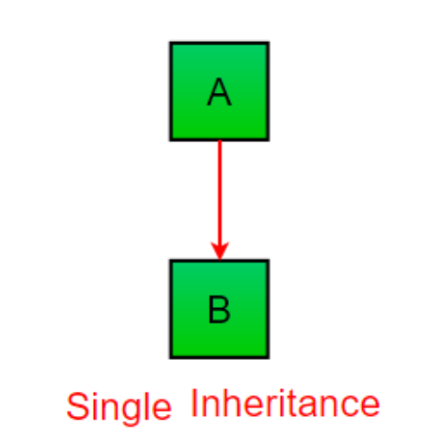
Single Inheritance
Single inheritance enables a derived class to inherit properties from a single parent class, thus enabling code reusability and the addition of new features to existing code.
class Parent:
def f1(self):
print("This function is in parent class.")
class Child(Parent):
def f2(self):
print("This function is in child class.")
object = Child()
object.f1()
object.f2()

Slide 149
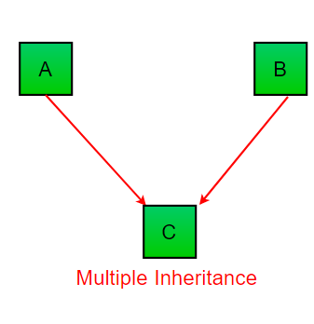
Multiple Inheritance
When a class can be derived from more than one base class this type of inheritance is called multiple inheritance. In multiple inheritance, all the features of the base classes are inherited into the derived class.

Slide 150
Multi Threading
Executing several tasks simultaneously is the concept of multitasking.
There are 2 types of Multi Tasking
1. Process based Multi Tasking:
Executing several tasks simmultaneously where each task is a seperate independent process is called process based multi tasking.
Eg: while typing python program in the editor we can listen mp3 audio songs from the same system. At the same time we can download a file from the internet. All these taks are executing simultaneously and independent of each other. Hence it is process based multi tasking.
This type of multi tasking is best suitable at operating system level.

Slide 151
2. Thread based MultiTasking:
Executing several tasks simultaneously where each task is a seperate independent part of the same program, is called Thread based multi tasking, and each independent part is called a Thread.
This type of multi tasking is best suitable at programmatic level.
Note: Whether it is process based or thread based, the main advantage of multi tasking is to improve performance of the system by reducing response time.
The main important application areas of multi threading are:
1. To implement Multimedia graphics
2. To develop animations
3. To develop video games
4. To develop web and application servers
etc...

Slide 152
Note: Where ever a group of independent jobs are available, then it is highly recommended to execute simultaneously instead of executing one by one.For such type of cases we should go for Multi Threading.
Python provides one inbuilt module "threading" to provide support for developing threads. Hence developing multi threaded Programs is very easy in python.
Every Python Program by default contains one thread which is nothing but MainThread.
Note: threading module contains function current_thread() which returns the current executing Thread object. On this object if we call getName() method then we will get current executing thread name.
Q.Program to print name of current executing thread:
import threading
print("Current Executing Thread:",threading.current_thread().getName())

Slide 153
The ways of Creating Thread in Python:
We can create a thread in Python by using 3 ways
1. Creating a Thread without using any class
2. Creating a Thread by extending Thread class
3. Creating a Thread without extending Thread class

Slide 154
1. Creating a Thread without using any class:
If multiple threads present in our program, then we cannot expect execution order and hence we cannot expect exact output for the multi threaded programs. B'z of this we cannot provide exact output for the above program. It is varied from machine to machine and run to run.
Note: Thread is a pre defined class present in threading module which can be used to create ourown Threads.
from threading import *
def display():
for i in range(1,11):
print("Child Thread")
t=Thread(target=display)
t.start()
for i in range(1,11):
print("Main Thread")

Slide 155
2. Creating a Thread by extending Thread class
We have to create child class for Thread class. In that child class we have to override run() method with our required job. Whenever we call start() method then automatically run() method will be executed and performs our job.
from threading import *
class MyThread(Thread):
def run(self):
for i in range(10):
print("Child Thread-1")
t=MyThread()
t.start()
for i in range(10):
print("Main Thread-1")

Slide 156
3. Creating a Thread without extending Thread class:
from threading import *
class Test:
def display(self):
for i in range(10):
print("Child Thread-2")
obj=Test()
t=Thread(target=obj.display)
t.start()
for i in range(10):
print("Main Thread-2")

Slide 157
Without multi threading: With multithreading:
from threading import *
import time
def doubles(numbers):
for n in numbers:
time.sleep(1)
print("Double:",2*n)
def squares(numbers):
for n in numbers:
time.sleep(1)
print("Square:",n*n)
numbers=[1,2,3,4,5,6]
begintime=time.time()
t1=Thread(target=doubles,args=(numbers,))
t2=Thread(target=squares,args=(numbers,))
t1.start()
t2.start()
t1.join()
t2.join()
print("The total time taken:",time.time()-begintime)
from threading import *
import time
def doubles(numbers):
for n in numbers:
time.sleep(1)
print("Double:",2*n)
def squares(numbers):
for n in numbers:
time.sleep(1)
print("Square:",n*n)
numbers=[1,2,3,4,5,6]
begintime=time.time()
doubles(numbers)
squares(numbers)
print("The total time taken:",time.time()-begintime)

Slide 158
MYSQL PYTHON
1. pip install mysql-connector-python
2. Creating connection with the mysql server.
3. creating a cursor to execute the command.
4. To check all Databases.
import mysql.connector
conn = mysql.connector.connect(
host="localhost",
user="root",
password=""
)
mycursor.execute("SHOW DATABASES") for x in mycursor: print(x)
mycursor = conn.cursor() mycursor.execute("CREATE DATABASE mydatabase")

Slide 159
Create a Table
Try connecting to the database “database":
Now creating a new table
SHOW ALL TABLES:-
mycursor.execute("SHOW TABLES") for x in mycursor: print(x)
mydb = mysql.connector.connect( host="localhost", user="yourusername", password="yourpassword", database="mydatabase" )
mycursor.execute("CREATE TABLE users (id INT(10), name VARCHAR(255), address VARCHAR(255))")

Slide 160
INSERT new record
mydb.commit(). It is required to make the changes,
otherwise no changes are made to the table.
For Insert Multiple Rows
executemany() method is a list of tuples,
sql = "INSERT INTO emp (name, address) VALUES (%s, %s)" val = (“xyz", “lucknow") mycursor.execute(sql, val) mydb.commit() print(mycursor.rowcount, "record inserted.")
sql = "INSERT INTO customers (name, address) VALUES (%s, %s)" val = [ ('Peter', 'Lowstreet 4'), ('Amy', 'Apple st 652'), ('Hannah', 'Mountain 21'), ('Michael', 'Valley 345'), ('Sandy', 'Ocean blvd 2'), ('Betty', 'Green Grass 1'), ('Richard', 'Sky st 331'), ('Susan', 'One way 98'), ('Vicky', 'Yellow Garden 2'), ('Ben', 'Park Lane 38'), ('William', 'Central st 954'), ('Chuck', 'Main Road 989'), ('Viola', 'Sideway 1633') ] mycursor.executemany(sql, val) mydb.commit() print(mycursor.rowcount, “row inserted.")

